Slide 1
Classification:
Decision Tree Induction
C5483 Data Warehousing and Data Mining

Slide 2


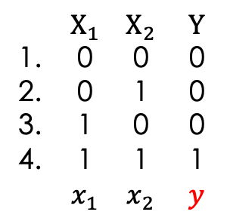
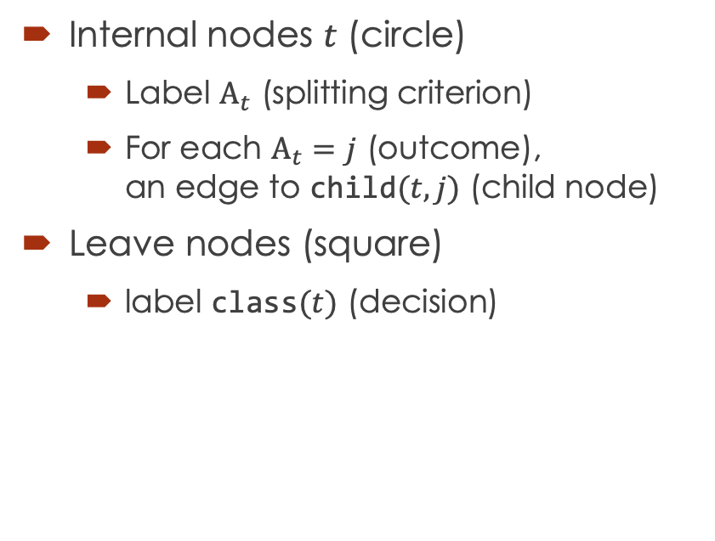












What is a decision tree?
Internal nodes $t$ (circle)
  Label $A_{t}$ (splitting criterion)
  For each $A_{t}=j$ (outcome),
  an edge to $\text{child}(t,j)$ (child node)
Leave nodes (square)
  label $\text{class}(t)$ (decision)
$$X_{1}$$
Node 0 (root)
$$A_{0}$$
0
1
$$\text{child}(0,0)$$
$$\text{child}(0,1)$$
Node 2
$$0$$
$$X_{2}$$
Node 1
$$\text{class}\left(2\right)$$
$$A_{1}$$
$$\text{child}(1,0)$$
0
1
$X_{1}$ $X_{2}$ $Y$
1. 0 0 0
2. 0 1 0
3. 1 0 0
4. 1 1 1
$x_{1}$ $x_{2}$ $y$
$$\text{child}(1,1)$$
Node 3
$$0$$
$$1$$
Node 4
$$\text{class}\left(3\right)$$
$$\text{class}\left(4\right)$$

Slide 3





How to classify?
Trace from root to leaves
$$x=\left(x_{1},x_{2}\right)=(1,0)$$
$$X_{1}$$
Input: feature vector $x$
Output: predicted class $\hat{y}$
$t←\text{root}$
while $t$ is not a leaf
$t←\text{child}(t,j)$ where $A_{t}=j$ for $x$
$\hat{y}←\text{class}(t)$
0
$$x_{1}=$$
1
$$0$$
$$X_{2}$$
$$x_{2}=$$
0
1
$$\hat{y}=$$
$$0$$
$$1$$

Slide 4



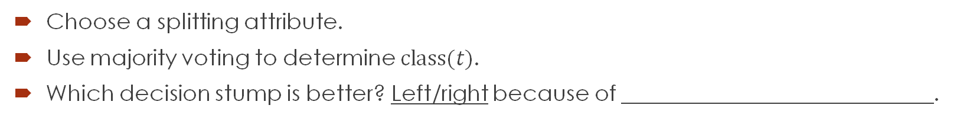



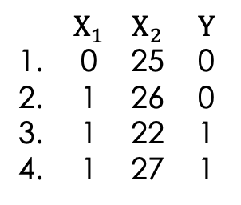

How to build a decision stump?
A decision stump is a decision tree with depth $≤$1.
$X_{1}$ $X_{2}$ $Y$
1. 0 25 0
2. 1 26 0
3. 1 22 1
4. 1 27 1
$$X_{1}$$
$$i$$ | 1 | 2 | 3 | 4
$$y_{i}$$ | 0 | 0 | 1 | 1
$$X_{2}$$
0
1
22
25
26
27
2 | 3 | 4
0 | 1 | 1
3
1
1
0
2
0
4
1
$$0$$
1
0
$$1$$
2
0
_
$$\text{_}$$
$$\text{_}$$
$$\text{_}$$
error rate = _______
error rate = _______
Choose a splitting attribute.
Use majority voting to determine $\text{class}(t)$.
Which decision stump is better? Left/right because of ____________________________.

Slide 5





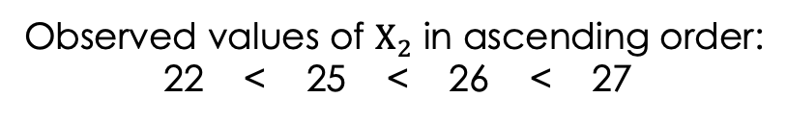


Binary splits for numeric attributes
Observed values of $X_{2}$ in ascending order:
22 < 25 < 26 < 27
$X_{1}$ $X_{2}$ $Y$
1. 0 25 0
2. 1 26 0
3. 1 22 1
4. 1 27 1
$X_{2}$>23.5
$X_{2}$>25.5
$X_{2}$>26.5
F
T
F
T
F
T
$$1$$
3
1
$$0$$
1 | 2 | 4
0 | 0 | 1
$$0$$
1 | 3
0 | 1
$$0$$
2 | 4
0 | 1
$$0$$
1 | 2 | 3
0 | 0 | 1
$$1$$
4
1
c___________ m___-points as s______________ points.
Which is/are the best split(s)? ______________
How to build a tree instead of a stump? R_________ly split (d_______ and c_____).

Slide 6
















How to build a decision tree?
Greedy algorithm (See Han11 Fig 8.3 for the full version)
$$1,2,3,4$$
$$,5$$
$$,6$$
Input: training data $D$
Output: root node of the decision tree
function $\text{Split}(D)$
create node $t$
$A_{t}←$ a good criterion $A$ to split $D$
if $A_{t}$ is not null
for each outcome $j$ of $A_{t}$
$D_{j}←\{\left(x,y\right)∈D|x \text{satisfies} A_{t}=j\}$
$\text{child}(t,j)←$ _____ if $D_{j}≠∅$
else _____
else # further splitting is not useful when _____
$\text{class}(t)←$ _____
return $t$
$X_{1}$ $X_{2}$ $Y$
1. 0 0 0
2. 0 1 0
3. 1 0 0
4. 1 1 1
$$X_{1}$$
$$1,2$$
0
1
$$,6$$
$$3,4$$
$$,5$$
0
$$X_{2}$$
5. 1 1 0
2
$$3$$
0
1
$$,5$$
6. 0 2 0
$$4$$
$$∅$$
0
1
_
(a) $\arg{\max_{k}\left|\{\left(x,y\right)∈D|y=k\}\right|}$
(b) new node $t^{′}$ with $\text{class}(t^{′})←\arg{\max_{k}\left|\{\left(x,y\right)∈D|y=k\}\right|}$
(c) $\text{Split}\left(D_{j}\right)$

Slide 7







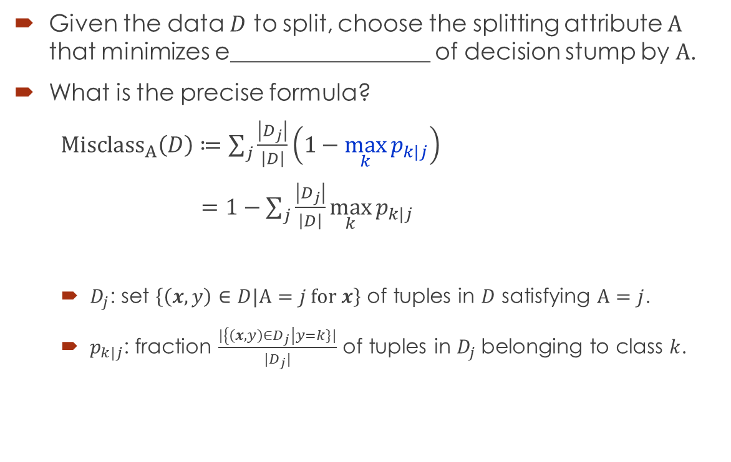









How to find good splitting attribute?
Given the data $D$ to split, choose the splitting attribute $A$ that minimizes e_________________ of decision stump by $A$.
What is the precise formula?
${\text{Misclass}}_{A}\left(D\right)≔\sum_{j}{\frac{\left|D_{j}\right|}{\left|D\right|}\left(1−\max_{k}{p_{k|j}}\right)}$
$=1−\sum_{j}{\frac{\left|D_{j}\right|}{\left|D\right|}}\max_{k}{p_{k|j}}$
  $D_{j}$: set $\left\{\left(x,y\right)∈D|A=j \text{for} x\right\}$ of tuples in $D$ satisfying $A=j$.
  $p_{k|j}$: fraction $\frac{|\left\{\left(x,y\right)∈D_{j}\right|y=k\}|}{|D_{j}|}$ of tuples in $D_{j}$belonging to class $k$.
$$D$$
$$i$$ | 1 | 2 | 3 | 4
$$y_{i}$$ | 0 | 0 | 1 | 1
$$X_{1}$$
0
1
$$D_{0}$$
$$D_{1}$$
$$0$$
1
0
$$1$$
2 | 3 | 4
0 | 1 | 1
accuracy
$\frac{\left|D_{0}\right|}{\left|D\right|}=\frac{1}{4}$
$\frac{\left|D_{1}\right|}{\left|D\right|}=$___
$$p_{0|0}=1$$
$$p_{0|1}=\frac{1}{3}$$
$$p_{1|0}=0$$
$$p_{1|1}=\text{____}$$
$$\max_{k}{p_{k|0}}$$
$$\max_{k}{p_{k|1}}$$
${\text{Misclass}}_{X_{1}}\left(D\right)=$_____________

Slide 8





$$X_{1}$$
$X_{1}$ $X_{2}$ $X_{3}$ $Y$
1. 0 0 0 0
2. 0 0 0 0
3. 0 0 1 1
1 0 1 1
5. 0 1 0 2
6. 1 1 0 2
7. 1 1 1 3
8. 1 1 1 3
0
1
1 | 2 | 3 | 5
0 | 0 | 1 | 2
4 | 6 | 7 | 8
1 | 2 | 3 | 3
$${\text{M}\text{isclass}}_{X_{1}}\left(D\right)=_____$$
$$X_{2}$$
0
1
1 | 2 | 3 | 4
0 | 0 | 1 | 1
5 | 6 | 7 | 8
2 | 2 | 3 | 3
$${\text{M}\text{isclass}}_{X_{2}}\left(D\right)=______$$
What is the best splitting attribute? $X_{1}$ / $X_{2}$ / same

Slide 9







$$X_{1}$$
0
1
1 | 2 | 3 | 5
0 | 0 | 1 | 2
$$X_{3}$$
$$X_{3}$$
4 | 6 | 7 | 8
1 | 2 | 3 | 3
Further split on $X_{3}$
$X_{1}$ $X_{2}$ $X_{3}$ $Y$
1. 0 0 0 0
2. 0 0 0 0
3. 0 0 1 1
1 0 1 1
5. 0 1 0 2
6. 1 1 0 2
7. 1 1 1 3
8. 1 1 1 3
0
1
0
1
1 | 2 | 5
0 | 0 | 2
3
1
6
2
4 | 7 | 8
1 | 3 | 3
$$X_{2}$$
0
1
1 | 2 | 3 | 4
0 | 0 | 1 | 1
$$X_{3}$$
$$X_{3}$$
5 | 6 | 7 | 8
2 | 2 | 3 | 3
0
1
0
1
1 | 2
0 | 0
3 | 4
1 | 1
5 | 6
2 | 2
7 | 8
3 | 3

Slide 10



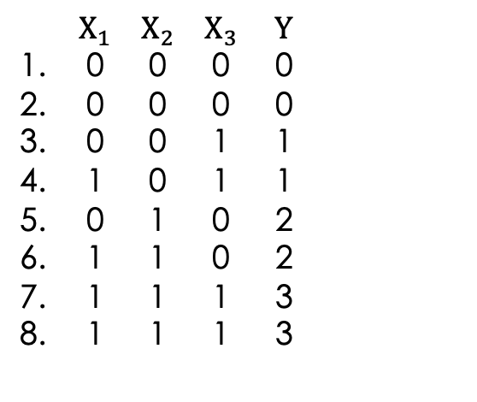




$$X_{1}$$
0
1
1 | 2 | 3 | 5
0 | 0 | 1 | 2
$$X_{3}$$
$$X_{3}$$
4 | 6 | 7 | 8
1 | 2 | 3 | 3
$X_{1}$ $X_{2}$ $X_{3}$ $Y$
1. 0 0 0 0
2. 0 0 0 0
3. 0 0 1 1
1 0 1 1
5. 0 1 0 2
6. 1 1 0 2
7. 1 1 1 3
8. 1 1 1 3
0
1
0
1
1 | 2 | 5
0 | 0 | 2
$$0$$
3
1
$$1$$
$$2$$
6
2
$$3$$
4 | 7 | 8
1 | 3 | 3
$$\text{Error} \text{rate}=_________$$
$$X_{2}$$
0
1
1 | 2 | 3 | 4
0 | 0 | 1 | 1
$$X_{3}$$
$$X_{3}$$
5 | 6 | 7 | 8
2 | 2 | 3 | 3
0
1
0
1
1 | 2
0 | 0
$$0$$
3 | 4
1 | 1
$$1$$
$$2$$
5 | 6
2 | 2
$$3$$
7 | 8
3 | 3
$$\text{Error} \text{rate}=__________$$

Slide 11



















Issue of greedy algorithm
Locally optimal split may not be g_______________ optimal.
Why splitting on $X_{1}$ is not good? Child nodes of $X_{1}$ are less p________.
Why misclassification rate fails?
It neglects the distribution of the class values of m__________________ instances.
$$p_{k|0}$$
$$X_{1}$$
$$p_{k|1}$$
$$p_{k|0}$$
$$X_{2}$$
$$p_{k|1}$$
$$k$$
0
1
$$k$$
$$k$$
0
1
$$k$$
1 | 2 | 3 | 5
0 | 0 | 1 | 2
$$X_{3}$$
$$X_{3}$$
4 | 6 | 7 | 8
1 | 2 | 3 | 3
1 | 2 | 3 | 4
0 | 0 | 1 | 1
$$X_{3}$$
$$X_{3}$$
5 | 6 | 7 | 8
2 | 2 | 3 | 3
0
1
0
1
0
1
0
1
1 | 2 | 5
0 | 0 | 2
$$0$$
3
1
$$1$$
$$2$$
6
2
$$3$$
4 | 7 | 8
1 | 3 | 3
1 | 2
0 | 0
$$0$$
3 | 4
1 | 1
$$1$$
$$2$$
5 | 6
2 | 2
$$3$$
7 | 8
3 | 3

Slide 12
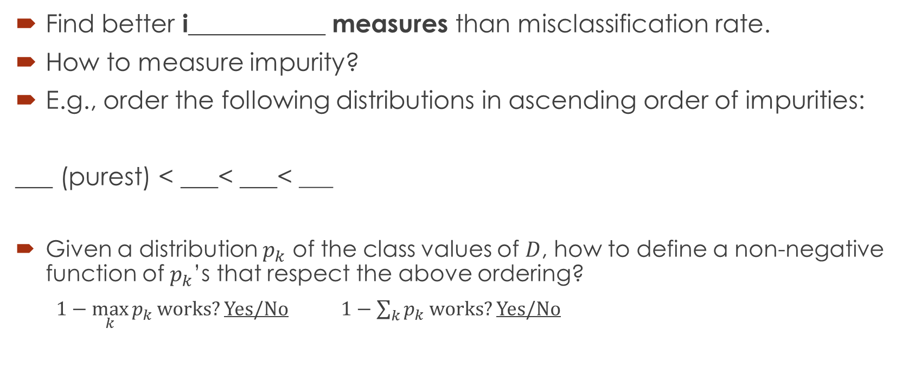
How to remain greedy but not myopic?
Find better i___________ measures than misclassification rate.
How to measure impurity?
E.g., order the following distributions in ascending order of impurities:
___ (purest) < ___< ___< ___
Given a distribution $p_{k}$ of the class values of $D$, how to define a non-negative function of $p_{k}$’s that respect the above ordering?
$1−\max_{k}{p_{k}}$ works? Yes/No $1−\sum_{k}{p_{k}}$ works? Yes/No
(i)
(ii)
(iii)
(iv)

Slide 13





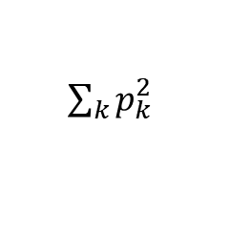



Gini impurity index
$$\text{Gini}\left(D\right)≔g\left(p_{0},p_{1},…\right)≔\sum_{k}{p_{k}\left(1−p_{k}\right)}=1−\sum_{k}{p_{k}^{2}}$$
$$p_{k}$$
$$p_{k}^{2}$$
$\sum_{k}{p_{k}^{2}}$
$$1$$
$$0.5$$
_____
_____
$$\text{Gini}\left(D\right)$$
$$0$$
$$0.5$$
_____
_____

Slide 14

Why it works?
$g\left(p_{0},p_{1},…\right)≥0$. Equality iff $∀k, p_{k}∈\left\{0,1\right\}$. Why?
$g\left(p_{0},p_{1},…, p_{n}\right)≤1−\frac{1}{n}$. Equality iff $p_{k}=$_________. Why?

Slide 15

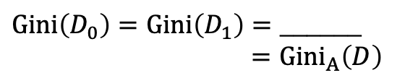
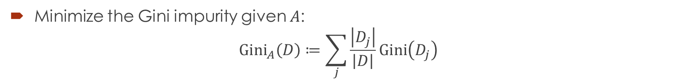

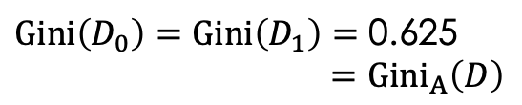

Finding the best split using Gini impurity
Minimize the Gini impurity given $A$:
$${\text{Gini}}_{A}\left(D\right)≔\sum_{j}{\frac{\left|D_{j}\right|}{\left|D\right|}\text{Gini}\left(D_{j}\right)}$$
$X_{1}$ $X_{2}$ $X_{3}$ $Y$
1. 0 0 0 0
2. 0 0 0 0
3. 0 0 1 1
1 0 1 1
5. 0 1 0 2
6. 1 1 0 2
7. 1 1 1 3
8. 1 1 1 3
$$X_{1}$$
$$X_{2}$$
0
1
0
1
1 | 2 | 3 | 5
0 | 0 | 1 | 2
4 | 6 | 7 | 8
1 | 2 | 3 | 3
1 | 2 | 3 | 4
0 | 0 | 1 | 1
5 | 6 | 7 | 8
2 | 2 | 3 | 3
$\text{Gini}\left(D_{0}\right)=\text{Gini}\left(D_{1}\right)=\text{0.625}$
$={\text{Gini}}_{A}\left(D\right)$
$\text{Gini}\left(D_{0}\right)=\text{Gini}\left(D_{1}\right)=\text{______}$
$={\text{Gini}}_{A}\left(D\right)$
What is the best splitting attribute? $X_{1}$ / $X_{2}$ / same

Slide 16







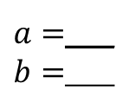



An impurity measure from information theory
Shannon’s entropy
$$\text{Info}\left(D\right)≔h\left(p_{1},p_{2},…\right) \\ ≔\sum_{k}{p_{k}\log{\frac{1}{p_{k}}}}=−\sum_{k:p_{k}>0}{p_{k}\log{p_{k}}}$$
Measured in bits with base-2 logarithm. Why?
$0\log{0}$ is regarded as $\lim_{p→0}{p\log{p}}$ even though $\log{0}$ is undefined.
$$p_{k}$$
$a=$___
$b=$___
$$p_{k}\log_{2}{\frac{1}{p_{k}}}$$
$$0,0,0,0$$
$$a,a,0,0$$
$$a,b,b,0$$
$b$,$b$,$b$,$b$
$$\text{Info}\left(D\right)$$
$$\text{0}$$
$$\text{_____}$$
_____
_____

Slide 17

Why it works?
$h\left(p_{0},p_{1},…\right)≥0$. Equality iff $∀k, p_{k}∈\left\{0,1\right\}$. Why?
$h\left(p_{0},p_{1},…, p_{n}\right)≤\log_{2}{n}$. Equality iff $p_{k}=$_________. Why?

Slide 18
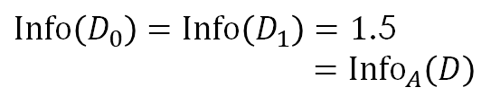
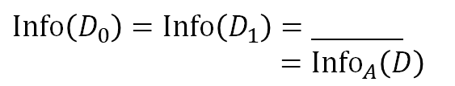
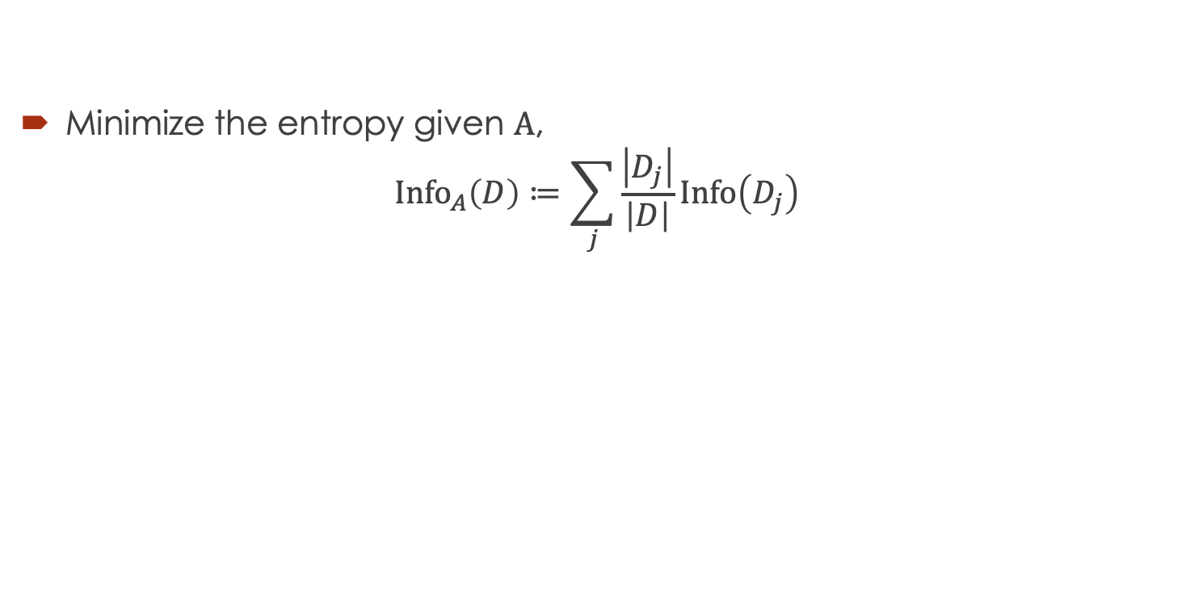


Finding the best split by conditional entropy
Minimize the entropy given $A$,
$${\text{Info}}_{A}\left(D\right)≔\sum_{j}{\frac{\left|D_{j}\right|}{\left|D\right|}\text{Info}\left(D_{j}\right)}$$
$X_{1}$ $X_{2}$ $X_{3}$ $Y$
1. 0 0 0 0
2. 0 0 0 0
3. 0 0 1 1
1 0 1 1
5. 0 1 0 2
6. 1 1 0 2
7. 1 1 1 3
8. 1 1 1 3
$$X_{1}$$
$$X_{2}$$
0
1
0
1
1 | 2 | 3 | 5
0 | 0 | 1 | 2
4 | 6 | 7 | 8
1 | 2 | 3 | 3
1 | 2 | 3 | 4
0 | 0 | 1 | 1
5 | 6 | 7 | 8
2 | 2 | 3 | 3
$\text{Info}\left(D_{0}\right)=\text{Info}\left(D_{1}\right)=\text{1}\text{.5}$
$={\text{Info}}_{A}\left(D\right)$
$\text{Info}\left(D_{0}\right)=\text{Info}\left(D_{1}\right)=\text{______}$
$={\text{Info}}_{A}\left(D\right)$
What is the best splitting attribute? $X_{1}$ / $X_{2}$ / same

Slide 19




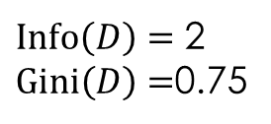

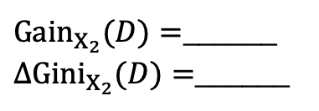

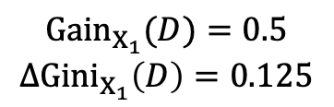
Which impurity measure is used?
ID3 (Iteractive Dichotomiser 3) maximizes
${\text{Gain}}_{A}(D)≔\text{Info}\left(D\right)−{\text{Info}}_{A}\left(D\right)$ (information gain or mutual information)
CART (Classification and Regression Tree)
$Δ{\text{Gini}}_{A}(D)≔\text{Gini}\left(D\right)−{\text{Gini}}_{A}\left(D\right)$ (Drop in Gini impurity)
$X_{1}$ $X_{2}$ $X_{3}$ $Y$
1. 0 0 0 0
2. 0 0 0 0
3. 0 0 1 1
1 0 1 1
5. 0 1 0 2
6. 1 1 0 2
7. 1 1 1 3
8. 1 1 1 3
$$X_{1}$$
$$X_{2}$$
0
1
0
1
1 | 2 | 3 | 5
0 | 0 | 1 | 2
4 | 6 | 7 | 8
1 | 2 | 3 | 3
1 | 2 | 3 | 4
0 | 0 | 1 | 1
5 | 6 | 7 | 8
2 | 2 | 3 | 3
$\text{Info}\left(D\right)=$ 2
$\text{Gini}\left(D\right)=$0.75
${\text{Info}}_{X_{1}}\left(D\right)=1.5$
${\text{Gini}}_{X_{1}}\left(D\right)=0.625$
$${\text{Gain}}_{X_{1}}(D)=\text{0.5}$$
$$Δ{\text{Gini}}_{X_{1}}\left(D\right)=0.125$$
${\text{Info}}_{X_{2}}\left(D\right)=1$
${\text{Gini}}_{X_{2}}(D)=0.5$
${\text{Gain}}_{X_{2}}(D)=$______
$Δ{\text{Gini}}_{X_{2}}(D)=$______
What is the best splitting attribute? $X_{1}$ / $X_{2}$ / same

Slide 20
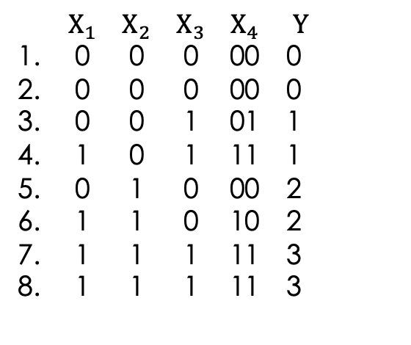





$$X_{1}$$
$X_{1}$ $X_{2}$ $X_{3}$ $X_{4}$ $Y$
1. 0 0 0 00 0
2. 0 0 0 00 0
3. 0 0 1 01 1
1 0 1 11 1
5. 0 1 0 00 2
6. 1 1 0 10 2
7. 1 1 1 11 3
8. 1 1 1 11 3
0
1
1 | 2 | 3 | 5
0 | 0 | 1 | 2
$$X_{3}$$
$$X_{3}$$
4 | 6 | 7 | 8
1 | 2 | 3 | 3
0
1
0
1
1 | 2 | 5
0 | 0 | 2
3
1
6
2
4 | 7 | 8
1 | 3 | 3
01
10
$X_{4}≔X_{1}∘X_{3}$
00
11
$$X_{4}$$
Is $X_{4}$ a good splitting attribute? Yes/No.

Slide 21
Bias towards attributes with many outcomes
An attribute with more outcomes tends to
  reduce impurity more but
  result in more comparisons.
Issues: Such attribute may not minimize impurity per comparison.
Remedies?

Slide 22






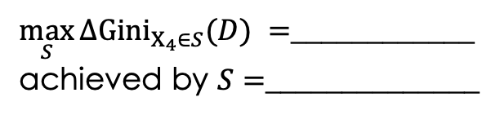
Binary split also for nominal attributes
CART uses a s___________________ $S$ to generate a binary split (whether $A∈S$).
The number of outcomes is therefore limited to ______.
$$X_{4}$$
$$X_{4}∈\{00,01\}$$
$$X_{4}∈\{00,10\}$$
00
11
T
F
T
F
01
10
1 | 2 | 5
0 | 0 | 2
3
1
6
2
4 | 7 | 8
1 | 3 | 3
1 | 2 | 5
0 | 0 | 2
3
1
6
2
4 | 7 | 8
1 | 3 | 3
1 | 2 | 5
0 | 0 | 2
6
2
3
1
4 | 7 | 8
1 | 3 | 3
$$X_{4}∈\{00,11\}$$
$$X_{4}∈\{00\}$$
$\max_{S}{Δ{\text{Gini}}_{X_{4}∈S}(D) }=$____________
achieved by $S=$______________
T
F
T
F
…
1 | 2 | 5
0 | 0 | 2
4 | 7 | 8
1 | 3 | 3
6
2
3
1
1 | 2 | 5
0 | 0 | 2
6
2
3
1
4 | 7 | 8
1 | 3 | 3

Slide 23

Normalization by split information
C4.5/J48 allows m___________ split but uses information gain ratio
$\frac{{\text{Gain}}_{A}(D)}{{\text{SplitInfo}}_{A}(D)}$ where ${\text{SplitInfo}}_{A}(D)=\sum_{j}{\frac{\left|D_{j}\right|}{\left|D\right|}\log_{2}{\frac{1}{\left|D_{j}\right|/\left|D\right|}}}.$
  ${\text{SplitInfo}}_{A}(D)$is the entropy of ______________________ because __________________.
  Attributes with many outcomes tend to have smaller/larger ${\text{SplitInfo}}_{A}(D)$.

Slide 24
How to avoid overfitting
P__-pruning: Limit the size of the tree as we build it. E.g.,
  Ensure each node is supported by enough examples.
  (C4.5: minimum number of objects.)
  Split only if we are confident enough about the improvement.
  (C4.5: confidence factor.)
P__-pruning: Reduce the size of the tree after we build it. E.g.,
  Contract leaf nodes if complexity outweighs the risk.
  (CART: cost-complexity pruning)

Slide 25
References
8.1 Basic Concepts
8.2 Decision Tree Induction
Optional readings
  https://en.wikipedia.org/wiki/C4.5_algorithm
  Cover, T., & Thomas, J. (2006). Elements of information theory (2nd ed.). Hoboken, N.J.: Wiley-Interscience. Chapter 1 and 2.

